Slide 1
Data quality and integration
Copyright McGraw Hill, Rosen, Discrete Mathematics and its Applications

Slide 2
Data quality dimensions
All relevant data is recorded
The data agrees with itself
Entities are recorded once
The data is recorded correctly
The data are up to date
The data conform to their definitions

Slide 3
Data gathering
Source data can be dirty
Problems can arise due to:
Manual entry
No uniform standards for content and formats
Parallel data entry (may lead to duplicates)
Approximations, surrogates due to software/hardware constraints
Measurement errors

Slide 4
Data delivery
Transmission pipeline can cause problems
Information may be dropped or degraded by preprocessing:
Inappropriate aggregation
Nulls converted to default values
Loss of data:
Buffer overflows
Transmission problems
Problems in physical storage

Slide 5
Data integration
Combination of data can lead to errors
Often data is stored in separate warehouses and then combined for analysis (e.g., across departments)
Common source of problems
Heterogenous data: no common identifier, different field formats
Different definitions of entities/attributes
Time synchronization
Legacy data
Sociological factors

Slide 6
Common data quality problems
Missing values
Noise
Outliers
Duplicate data

Slide 7
Missing values
Reasons for missing values
Information is not collected (e.g., people decline to give their age)
Attributes may not be applicable to all cases (e.g., annual income is not applicable to children)
Ways to handle missing values
Eliminate entities with missing values
Ignore the missing values during analysis
Estimate (ie., impute) missing values
Replace with all possible values (weighted by their probabilities)

Slide 8
Noise
Noise refers to measurement error in data values
Could be random error or systematic (bias) error
Random errors are due to inconsistencies in measurement, i.e. lack of precision (some high and some low)
Example: different people reporting heights measured with a ruler (some may be an overestimate others may be an underestimate)

Slide 9
Noise
Noise refers to measurement error in data values
Could be random error or systematic (bias) error
Systematic errors are due to lack of precision, i.e. methodological/personal errors that consistently deviate in one direction
Example: heights measured with a “broken” ruler that is shorter than the numbers indicate

Slide 10

Outliers
Outliers are data objects with characteristics that are: considerably different than most of the other data objects in the data set
Could indicate “interesting” cases (if so, highlight in output of analysis)
Could indicate errors in the data (if so, remove or correct)

Slide 11
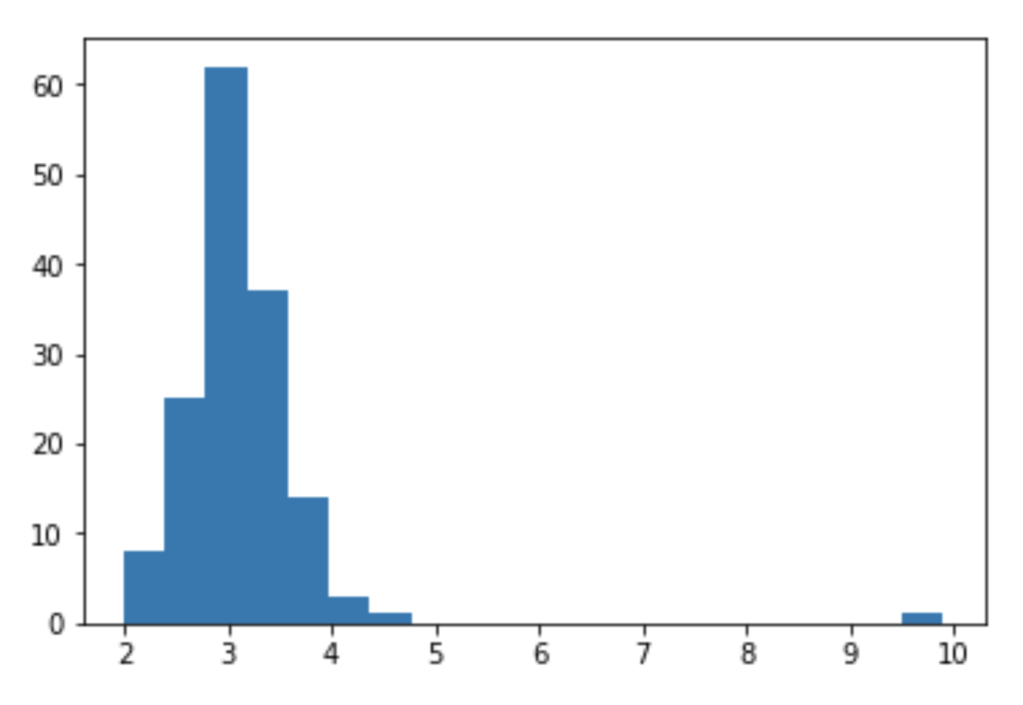
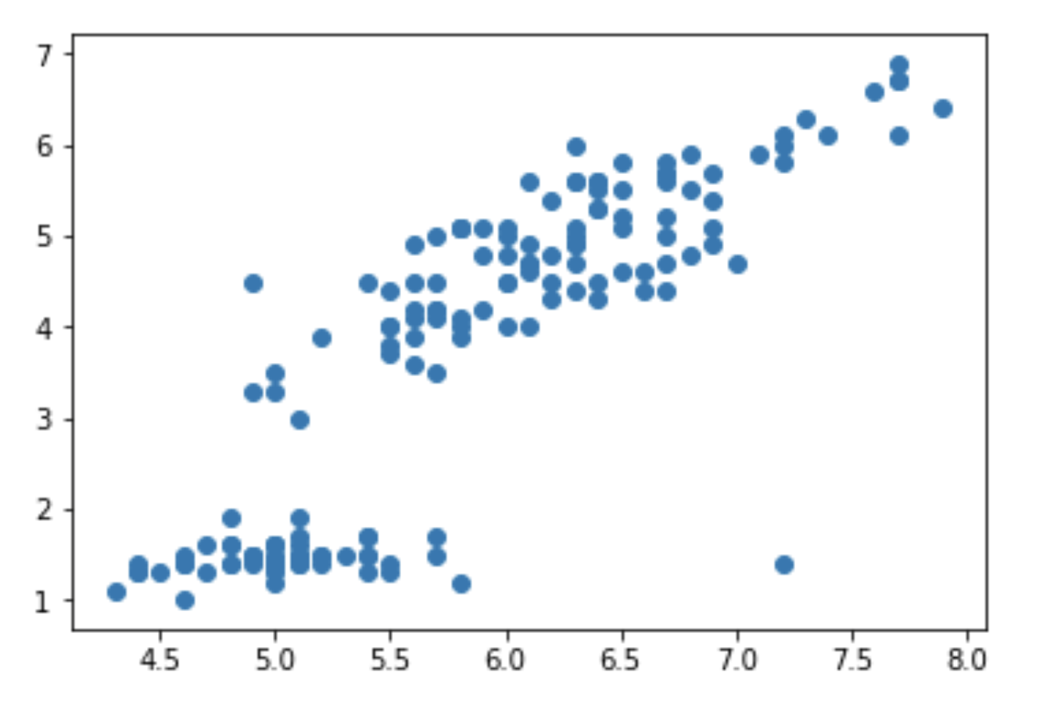
Finding outliers thru visualization

Slide 12
Finding outliers thru analysis
attrs = list(data.columns)
for i in range(4):
avg = data.iloc[:,i].mean()
std = data.iloc[:,i].std()
highthresh = avg + (2*std)
lowthresh = avg - (2*std)
outliers = data[(data[attrs[i]]>highthresh) | (data[attrs[i]]<lowthresh)]
print(outliers.iloc[:,i])
107 7.6
119 7.7
120 7.7
124 7.7
133 7.9
137 7.7
Name: sepal-length, dtype: float64
50 9.9
Name: sepal-width, dtype: float64
Series([], Name: petal-length, dtype: float64)
Series([], Name: petal-width, dtype: float64)

Slide 13
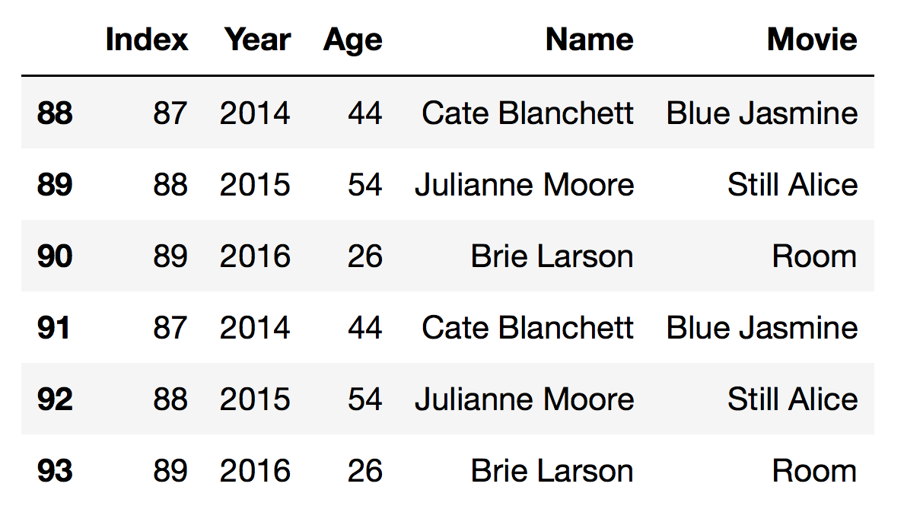
Finding duplicated data
# finding merge mistake where last three rows are added twice
data = pd.read_csv("oscar_age_female_mod.csv",sep=',')
data[data.duplicated(keep=False)]

Slide 14
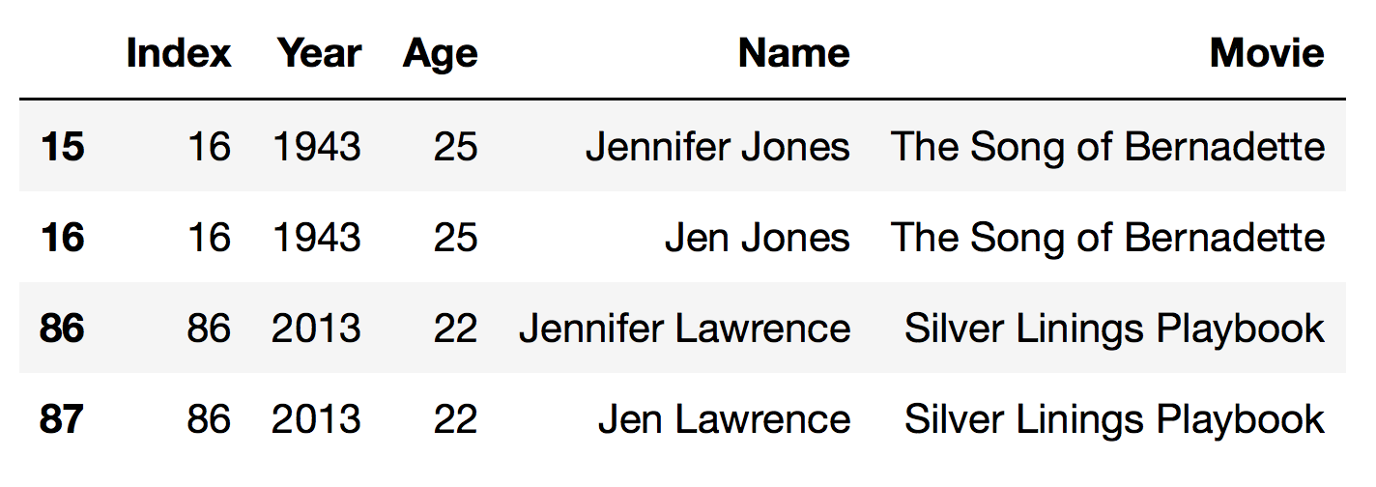
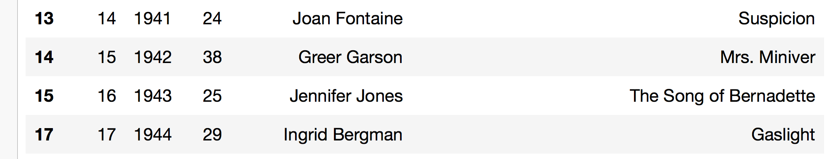
Finding duplicated data
# finding duplicates with different versions of name
data[data.duplicated([‘Index','Year'],keep=False)]
data.drop_duplicates(['Index','Year'],keep='first')

Slide 15
Data integration
Data is often available in multiple distinct databases and needs to be combined for analysis
When is data integration needed?
To analyze data produced by different sources
To combine data from different websites
To combine legacy databases
Two companies merge

Slide 16
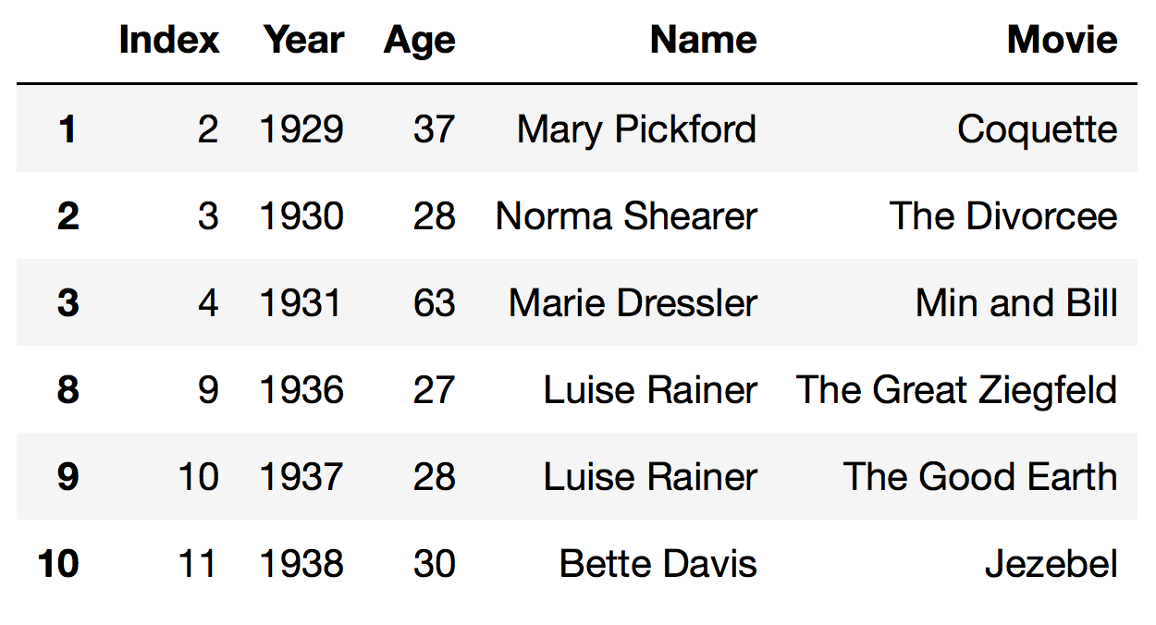
Merging data frames
# down select a few rows in different data fames
d1 = data.iloc[1:4,:]
d2 = data.iloc[8:11,:]
# concatenate the two data frames together
d3 = pd.concat([d1,d2])

Slide 17
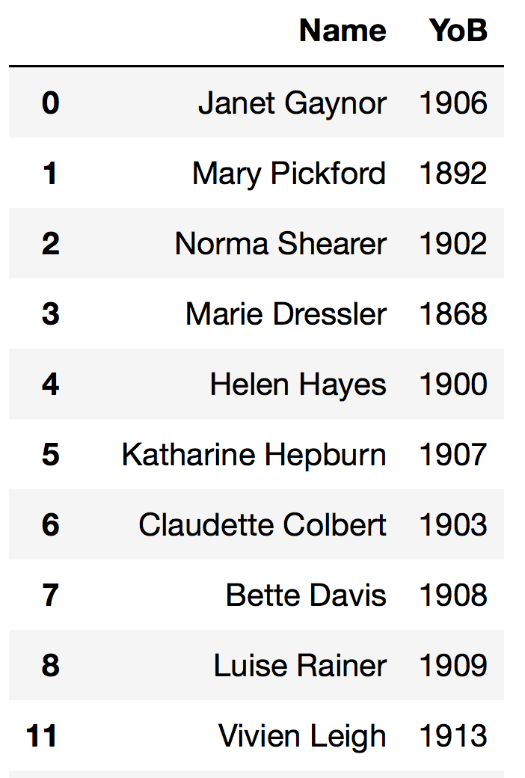
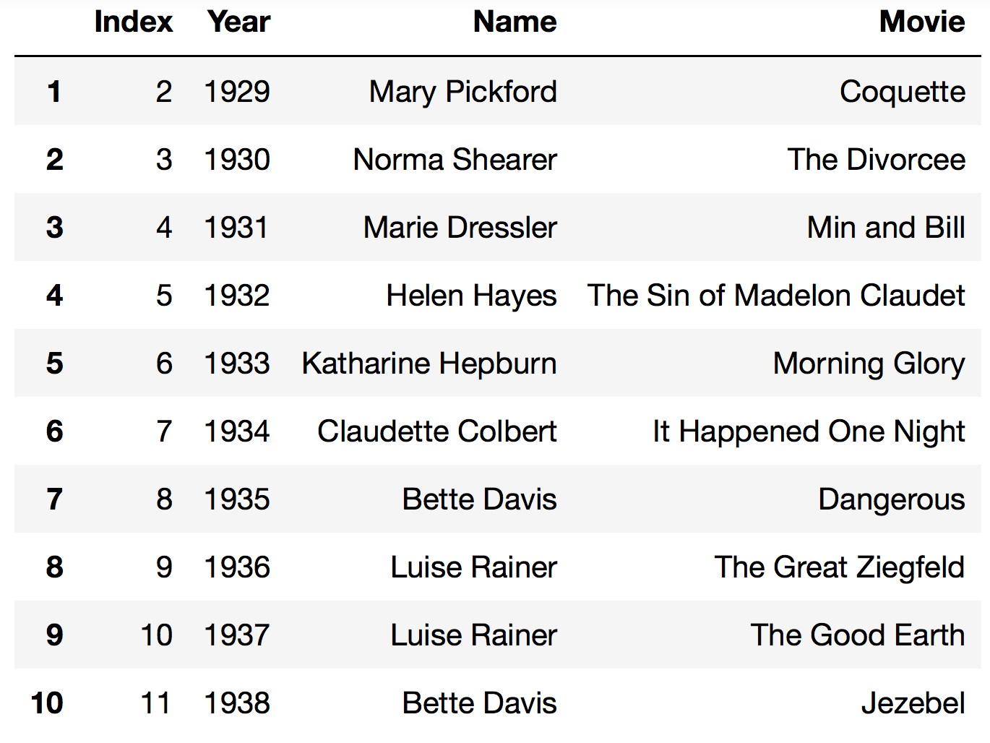
Merging data frames
# compute year of birth for actresses, get unique actress records
data['YoB'] = data.Year-data.Age
actress = data.iloc[:,[3,5]].drop_duplicates()
# get first ten movies
movies = data.iloc[1:11,[0,1,3,4]]

Slide 18
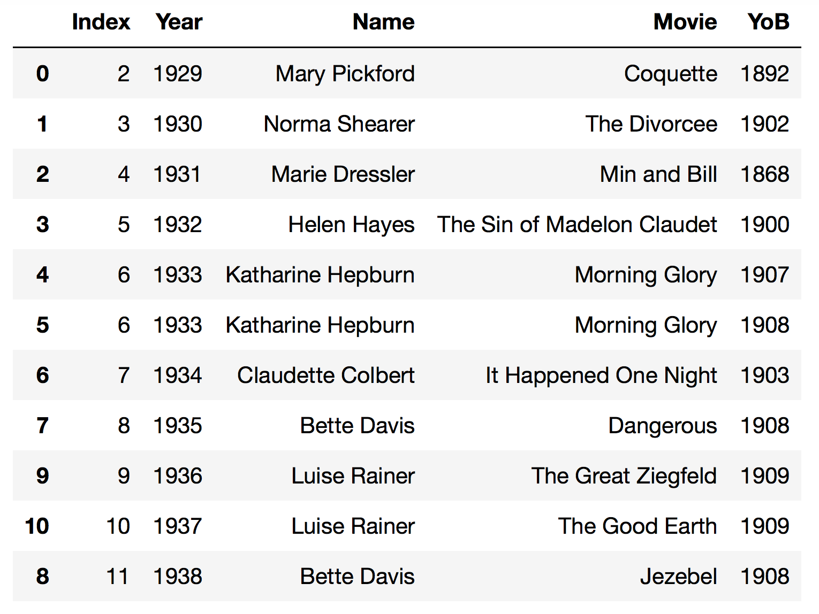
Merging data frames
# join actress information to movies
pd.merge(movies, actress, on='Name').sort_values('Year')

